Slide 1
Acoustic Beamforming for Hearing Aids

Slide 2
MOTIVATION
Why work on hearing aids?
1
2
Poverty and lower socioeconomic status
A scarcity of affordable housing

Slide 3
MOTIVATION
PROBLEM
Why work on hearing aids?
How can we assist the homeless both emotionally and professionally in our local communities?
1
2
Hearing loss affects everyone
They’re often too expensive to afford

Slide 4
1 in 5
3 in 5
Report some degree of hearing loss
Are in school or the workforce
1
1 in 3
over age 65
Will experience hearing loss
Hearing loss affects everyone
Source: Johns Hopkins Medicine
Notes:
Personal story first

Slide 5
4 in 5
$750 billion
Live in a low-middle income country
Is lost annually from unaddressed hearing loss
< 1 in 40
Has access to hearing aids
2
They’re often too expensive to afford
Source: World Health Org (WHO)
Notes:
Personal story first

Slide 6
Proposal
Create an inexpensive bone conduction hearing aid by leveraging recent advances in beamforming

Slide 7
Beamforming
A process that uses multiple inputs with directionality and time delays to amplify signals and reduce noise
1. Set up multiple microphones
Notes:
Beamforming requires multiple microphones, it then takes the audio inputs and combines them. In other words, it takes advantage of the phase delay between the two microphones to amplify the signal

Slide 8
Beamforming
A process that uses multiple inputs with directionality and time delays to amplify signals and reduce noise
1. Set up multiple microphones
Notes:
Two separate audio signals from the two different microphones
Notice that the waves are separated by a phase delay (since they’re spaced apart)

Slide 9
Beamforming
A process that uses multiple inputs with directionality and time delays to amplify signals and reduce noise
1. Set up multiple microphones
2. Apply phase (time) shift & combine
Notes:
We can split apart the red and the blue and programmatically shift the red line over on the graph. We can then add up the two signals to make the voice stronger

Slide 10
Beamforming
A process that uses multiple inputs with directionality and time delays to amplify signals and reduce noise
1. Set up multiple microphones
2. Apply phase (time) shift & combine
Notes:
Now, you might be wondering, won’t this just make the noise louder as well? It uses the fact that background noise won’t be in the same phase delay as the voice. So when we’re shifting the wave, it’ll actually shift the noise out of focus, so it’ll be distributing the noise and amplifying the voice.

Slide 11
Beamforming
A process that uses multiple inputs with directionality and time delays to amplify signals and reduce noise
1. Set up multiple microphones
2. Apply phase (time) shift & combine
Notes:
Now, you might be wondering, won’t this just make the noise louder as well? It uses the fact that background noise won’t be in the same phase delay as the voice. So when we’re shifting the wave, it’ll actually shift the noise out of focus, so it’ll be distributing the noise and amplifying the voice.

Slide 12

Beamforming
A process that uses multiple inputs with directionality and time delays to amplify signals and reduce noise
1. Set up multiple microphones
2. Apply phase (time) shift & combine
Unprocessed Audio
Processed
Generated from the CHiME3 Acoustic Speech Recognition Competition WSJ Dataset
Notes:
Now, you might be wondering, won’t this just make the noise louder as well? It uses the fact that background noise won’t be in the same phase delay as the voice. So when we’re shifting the wave, it’ll actually shift the noise out of focus, so it’ll be distributing the noise and amplifying the voice.

Slide 13
Beamforming
A process that uses multiple inputs with directionality and time delays to amplify signals and reduce noise
1. Set up multiple microphones
2. Apply phase (time) shift & combine
Unprocessed Audio
Processed
Generated from the CHiME3 Acoustic Speech Recognition Competition WSJ Dataset
Notes:
Now, you might be wondering, won’t this just make the noise louder as well? It uses the fact that background noise won’t be in the same phase delay as the voice. So when we’re shifting the wave, it’ll actually shift the noise out of focus, so it’ll be distributing the noise and amplifying the voice.

Slide 14
Beamforming
A process that uses multiple inputs with directionality and time delays to amplify signals and reduce noise
Limitations
1. Directionality is required
2. Difficulties filtering between voices and noise
Notes:
Now, you might be wondering, won’t this just make the noise louder as well? It uses the fact that background noise won’t be in the same phase delay as the voice. So when we’re shifting the wave, it’ll actually shift the noise out of focus, so it’ll be distributing the noise and amplifying the voice.

Slide 15
Bone Conduction Hearing Aid
1. Bone conduction
2. 3D printed case
3. Microphones & Arduino audio input
4. Shrinking & comparing with trimmer model hearing aids
Notes:
Bone conduction solves conducive hearing loss, which occurs in the middle and outer ears. Second most common type of hearing loss.

Slide 16
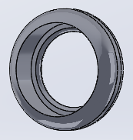
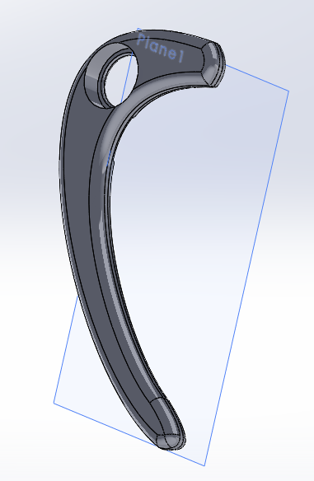
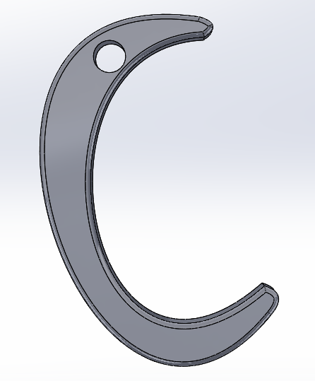
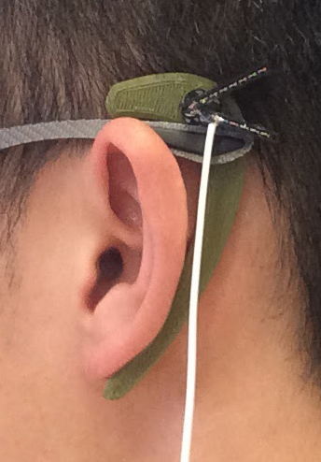
Bone Conduction Hearing Aid
1. Bone conduction
2. 3D printed case
3. Microphones & Arduino audio input
4. Shrinking & comparing with trimmer model hearing aids
Notes:
Bone conduction solves conducive hearing loss, which occurs in the middle and outer ears. Second most common type of hearing loss.

Slide 17
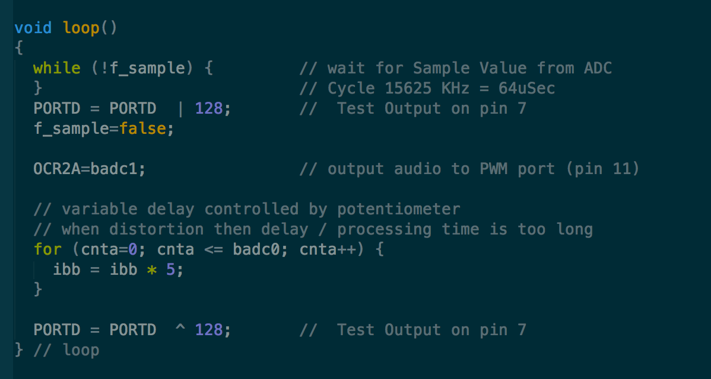
Bone Conduction Hearing Aid
1. Bone conduction
2. 3D printed case
3. Microphones & Arduino audio input
4. Shrinking & comparing with trimmer model hearing aids
Notes:
Bone conduction solves conducive hearing loss, which occurs in the middle and outer ears. Second most common type of hearing loss.

Slide 18
Bone Conduction Hearing Aid
1. Bone conduction
2. 3D printed case
3. Microphones & Arduino audio input
4. Shrinking & comparing with trimmer model hearing aids
Notes:
Putting code onto a smaller microprocessor with rechargeable battery & then comparing the results with a cheap commercial hearing aid

Slide 19
Post Senior Project
1. In talks with NGO hearing aid distributor
2. Greater access through crowdfunding

Slide 20
Demo!
Things to try:
Press the transducer (the metal part) against your skull behind your ear
Plug your ears for a better effect!
Press the transducer against your hand or your arm and stick your finger in your ear

Slide 21
Thank you!

Slide 22
Reference Slides

Slide 23
Microphones & Audio Processing
Sample sounds from both microphones @ 16kHz

Slide 24
Microphones & Audio Processing
Put beamforming logic onto the microprocessor

Slide 25

Motivation
Global
US
About 20% or 40 million people in the US report some degree of hearing loss
1 in every 3 people will have hearing loss at the age of 65
60 percent of the people with hearing loss are either in the work force or in educational settings.
US hearing aids costs are typically $800+ with models supporting Bluetooth around $2000
Source: Johns Hopkins Medicine
Source: wwhearing.org
Notes:
Personal story first

Slide 26
Beamforming: Limitations
Requires location & direction to determine proper phase delay
Determined dynamically in the hearing aid, though I can preprogram in the distance between the ears.
May confuse noise and sound
I’m taking the clearest sound and amplifying it, but may focus on specific frequencies to isolate noise later on

Slide 27
Bone Conduction
Conductive hearing loss is the second most common type of hearing loss
Middle or outer ear damage
Bone conduction solves this by only using the inner ear

Slide 28
Bone Conduction
Inner ear converts sound into electrical signals to your brain

Slide 29
3D Printed Case
3D printed case with audio prototype

